Slide 1
INTRODUCTION
Fire detection systems are designed to discover fires early in their development when time will still be available for the safe evacuation of occupants. Early detection also plays a significant role in protecting the safety of emergency response personnel. Property loss can be reduced and downtime for the operation minimized through early detection because control efforts are started while the fire is still small. Most alarm systems provide information to emergency responders on the location of the fire, speeding the process of fire control.

Slide 2
Why is Fire detection needed?
Detect fire in the areas
Initiate automatic fire control and suppression system and to sound alarm
Summon organized assistance to initiate or assist in fire control activities
Monitor levels of carbon dioxide
Supervise fire control and suppression system to assure operational status in maintained auxiliary functions involving environmental , utility and process control

Slide 3

STEP 1:PURPOSE AND REQUIREMENTS
PURPOSE: To detect the flame of the fire and provides warning signals in the form of alarm.
BEHAVIOUR: It has an auto mode. It detects the flame and automatically produces the alarm.
SYSTEM MANAGEMENT REQUIREMENT: The system provides manual control in case of false alarm.
DATA ANALYSIS REQUIREMENT: The proposed system is completely dependent on local analysis of data.
APPLICATION DEPLOYMENT REQUIREMENT: It allows the user to get the notification service; deployed locally on device.
SECURITY REQUIREMENT: As per now, the only security it provides is the alarm notification and also user authentication.

Slide 4
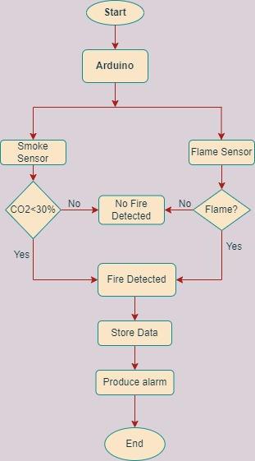
STEP 2:PROCESS MODEL SPECIFICATION
The second step in the IOT design methodology is to define the Process Specification .
In this step ,the use cases of the IOT system are formally described based on and derived from the purpose and requirement specifications .
This Fig shows the process diagram for the
Fire Detection System
In this use case : –
Circle - denotes a start and end of a process
Diamond - denotes a decision box
Rectangle - denotes a state or attribute

Slide 5
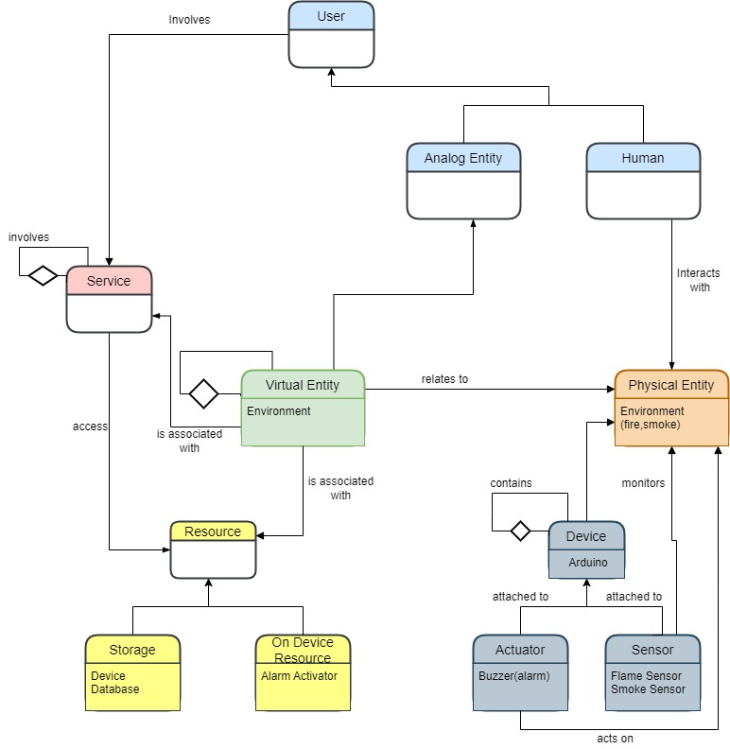
STEP 3:DOMAIN MODEL SPECIFICATION
The third step in the IOT design methodology is to define the Domain Model.
The domain model describes the main concepts ,entities and objects in the domain of IOT system to be designed. Domain model defines the attributes of the objects and relationships between objects.
Domain model provides an abstract representation of the concepts ,objects and entities in the IOT domain , independent of any specific technology or platform.

Slide 6
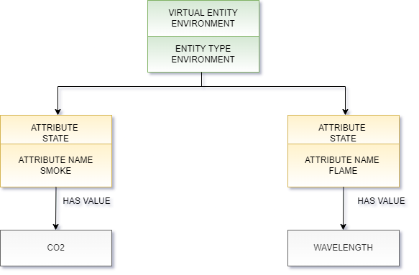
STEP 4:INFORMATION MODEL SPECIFICATION
The fourth step in the IoT design methodology is to define the Information Model.
Information Model defines the structure of all the information in the IoT system, for example, attributes of Virtual Entities, relations, etc.
Information model does not describe the specifics of how the information is represented or stored.
To define the information model, we first list the Virtual Entities defined in the Domain Model.
Information model adds more details to the Virtual Entities by defining their attributes and relations.

Slide 7
STEP 5:SERVICE MODEL SPECIFICATION
The fifth step in the IOT design methodology is to define the Service Specification.
Service specifications define the services in the IoT system, service types, service inputs/output, service endpoints service schedules, service preconditions and service effects.
STATE SERVICE:
Sets the Arduino to activate the sensor as soon as the flame and/or smoke is/are detected.
CONTROLLER SERVICE:
If either of smoke and flame or both have been detected in the proximity of the sensors, the controller service sends the signal to the siren/buzzer and buzzer gets activated.

Slide 8
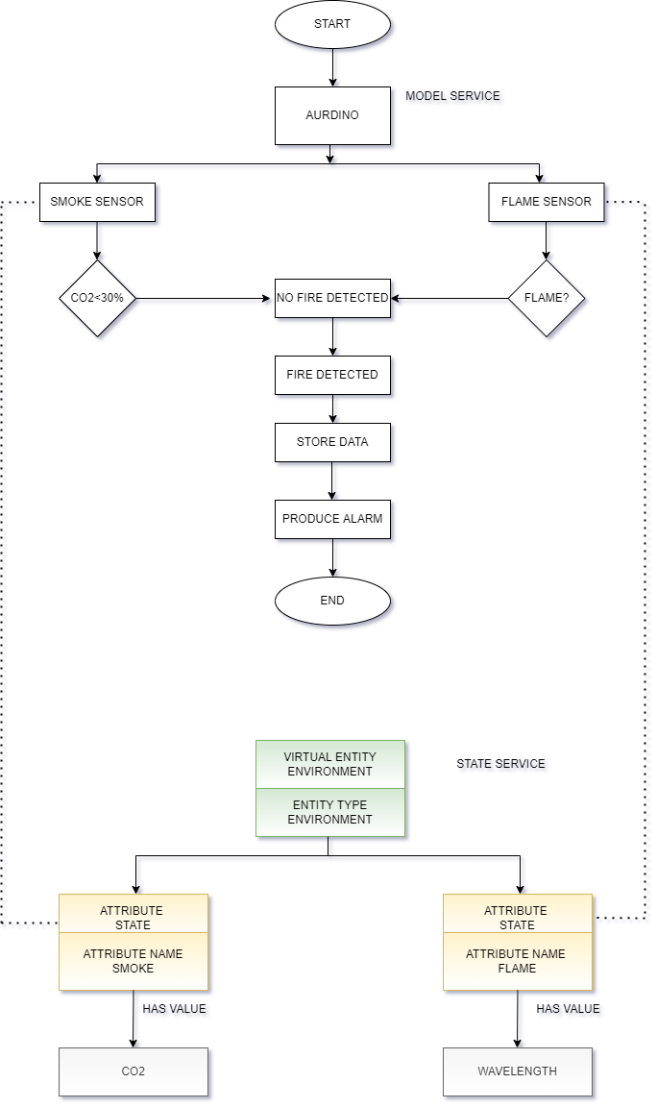
Process specification
Service Specification Model

Slide 9
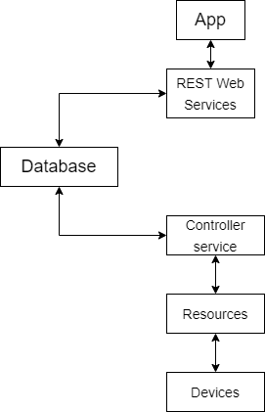
STEP 6:IOT LEVEL SPECIFICATION
A level-1 IoT system has a single node/device that performs sensing and/or actuation, stores data, performs analysis and hosts the application.
Level-1 IoT systems are suitable for modelling low- cost and low-complexity solutions where the data involved is not big and the analysis requirements are not computationally intensive.
IOT LEVEL-1

Slide 10
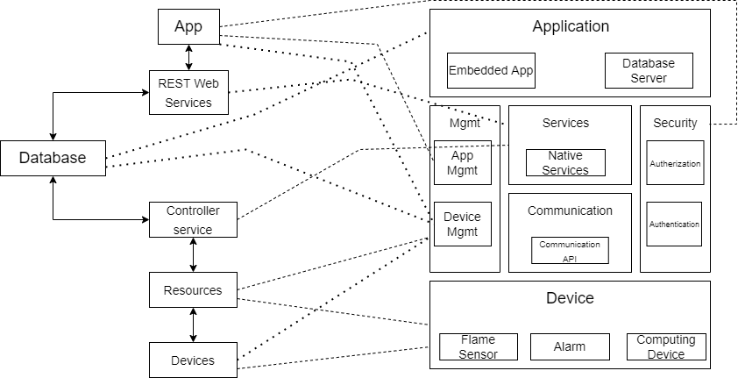
STEP 7:FUNCTIONAL VIEW SPECIFICATION

Slide 11
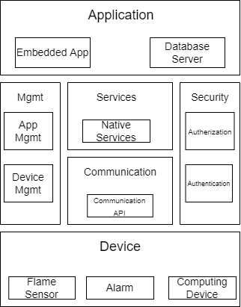
STEP 8:OPERATIONAL VIEW SPECIFICATION
DEVICE:
Flame Sensor
Smoke Sensor
Computing Device
COMMUNICATION:
REST API
SERVICES:
Native Device Service
Aurdino Controller Services
MANAGEMENT:
Device Management
Embedded App Management
SECURITY:
Authentication of user
APPLICATION:
Embedded App

Slide 12
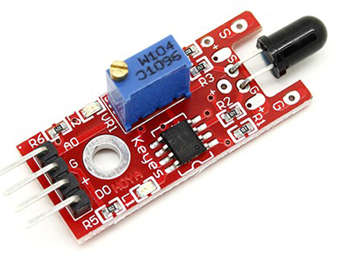
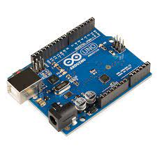
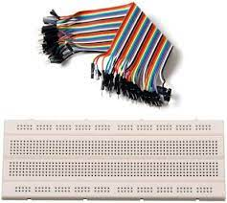
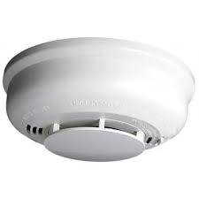
STEP 9:DEVICE AND COMPONENT INTEGRATION
The Hardware Components include:
Flame Sensor
Smoke Sensor
Breadboard
Arduino
Jumper wires
Battery
The Software Components include
Arduino IDE

Slide 13
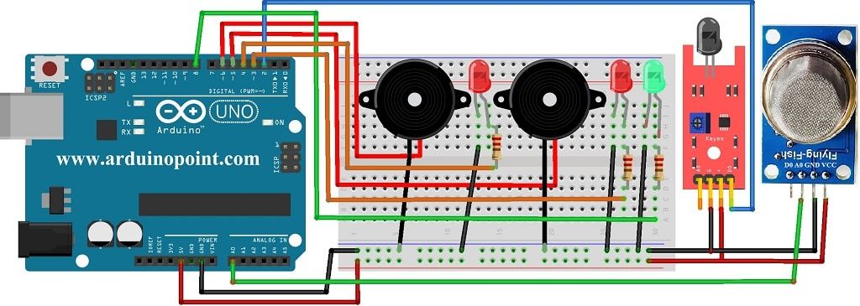
PIN DIAGRAM:

Slide 14
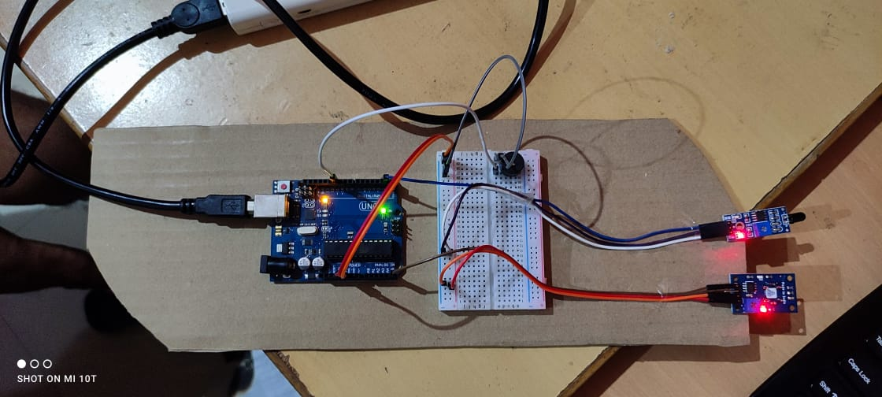
STEP 10:APPLICATION DEVELOPMENT
The automatic Fire Detection device proposed in this activity is ultimately expected to contribute to automatic fire and smoke detection and produce an alarm.
At present time the world needs this product.
It is very demandable for smart and cost-effective devices.
The demo of this product is :

Slide 15
THANK YOU

